Slide 1
App in an Hour
Microsoft Power Platform
Power Apps
Power Automate
AI Builder Card Reader
Business Process Flows
Power Apps portals

Slide 2
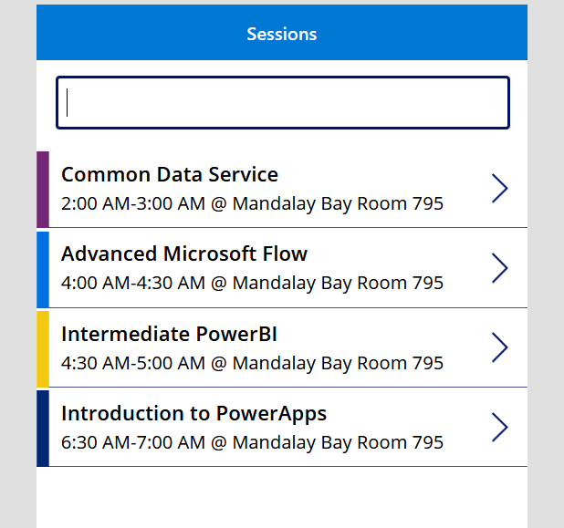
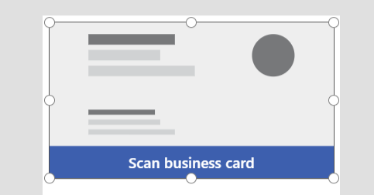
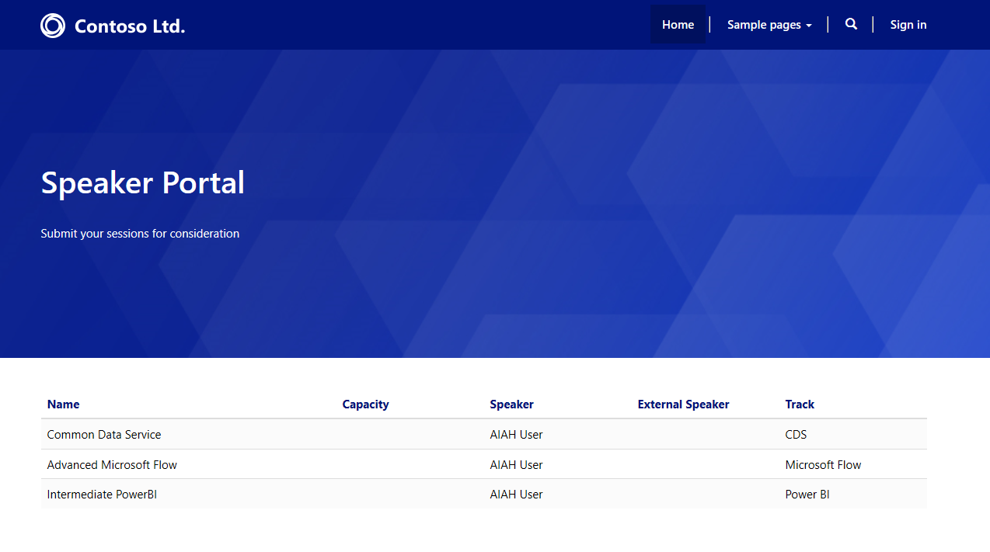
Lab objectives
Prepare environment and the data model
Build a Power Apps Model-Driven app for the conference administrators
Build a Power Apps Canvas app for the conference attendees
Bonus
Add Business Card Reader to the Canvas app
Make external speaker session submission using Portals
Create Business Process Flow for the session entity
Use Power Automate to build an approval workflow for session approval
Notes:
Today the main objective is to understand how to prepare an environment and data model using the Common Data Service. We will build a model driven app and a canvas app based on the data model. Although we probably won’t have time to cover everything today, the lab manual also contains instructions on how to add an AI Builder business card reader, Power Portals, Business Process Flows, and Power Automate Approvals

Slide 3
Power Apps Canvas App

Slide 4
Learning objectives
Sign-in and create a new canvas app
Connect to data sources
Work with multiple screens and navigation
Customize the user experience – galleries and controls

Slide 5
Power Apps model-driven app

Slide 6
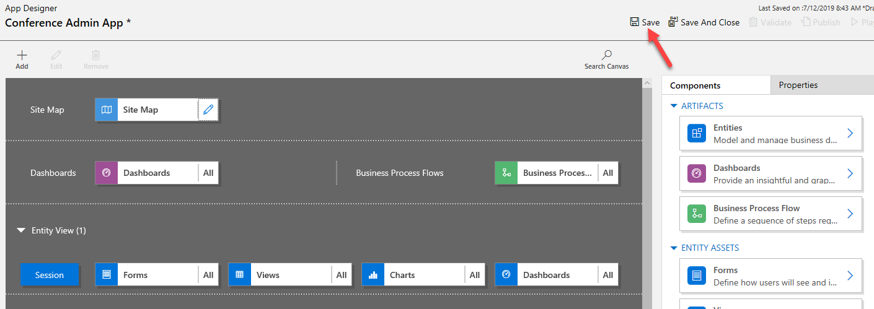
Learning objectives
Create a standalone model-driven app
Customize forms for the model-driven app

Slide 7
Power Automate

Slide 8
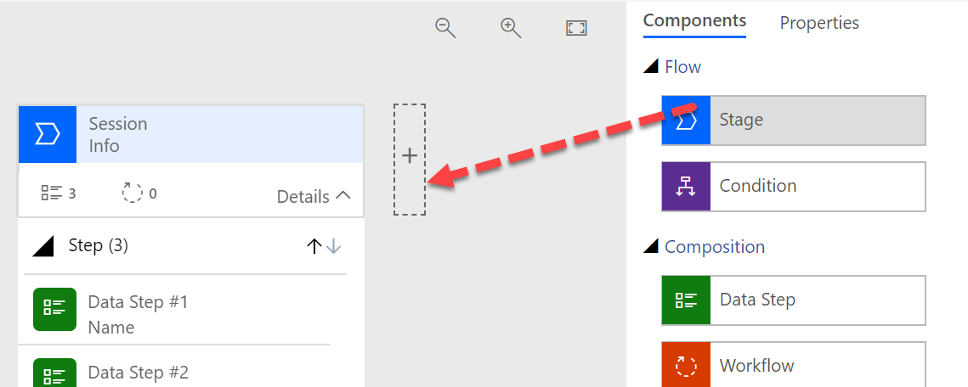
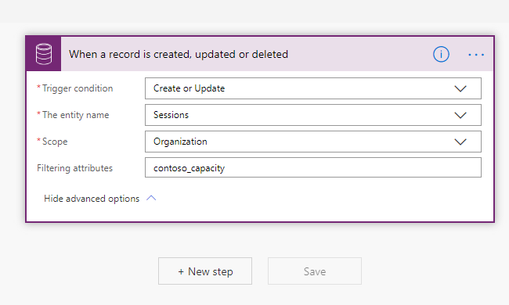
Learning objectives
Trigger a flow when a new record is created or updated in CDS
Send an approval request
Conditional branching based on the approval response
Send email notifications
Update the CDS record with the approval status

Slide 9
Business Card Reader

Slide 10
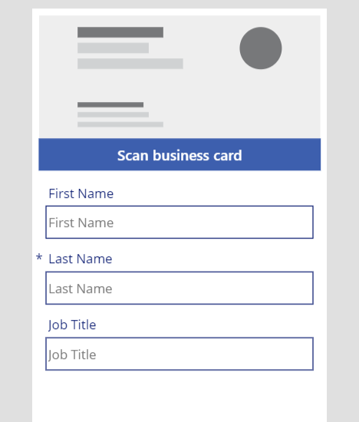
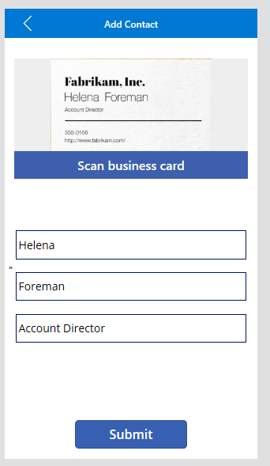
Learning objectives
Add screens to canvas application
Add AI Builder business bard beader
Create contact for and edit to meet your needs
Map card reader results to the form fields
Create a new CDS contact record from the business card reader result

Slide 11
Power Apps portal app

Slide 12
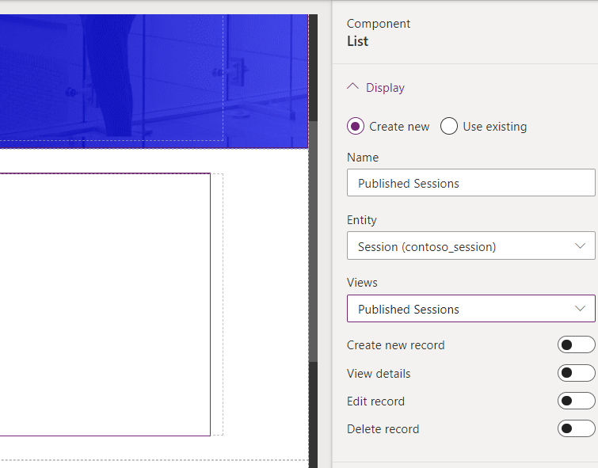
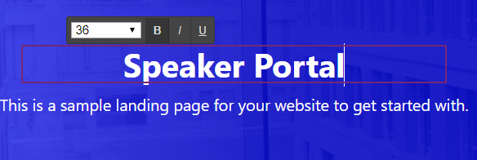
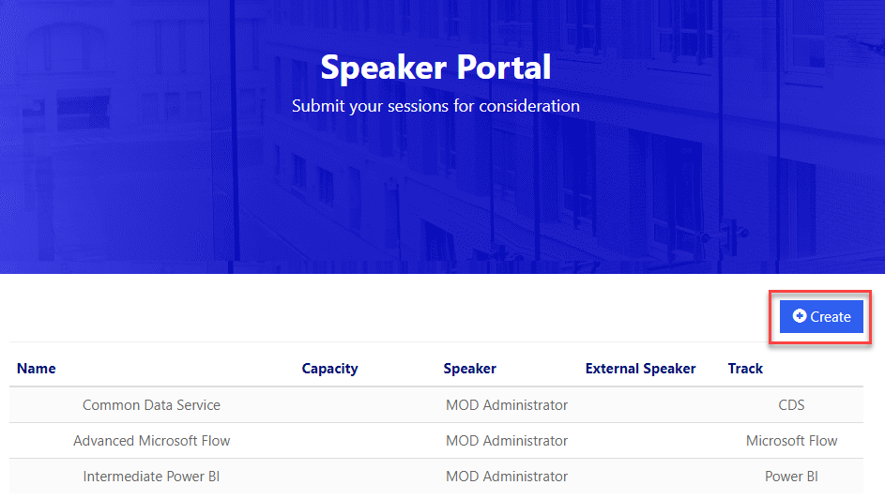
Learning objectives
Create external speaker form
Show list of sessions in the portal
Add child page to portal page
Allow speakers to create new sessions

